Slide 1
Send your check-ins
Next Tuesday: 4th day of presentations (Learning Theory)
Teams:
Sathya Ronak
Alisha Zach
Devin Josh
Scribe (2 students)

Slide 2

Dimitris Papailiopoulos
Serially Equivalent + Scalable
Parallel Machine Learning

Slide 3
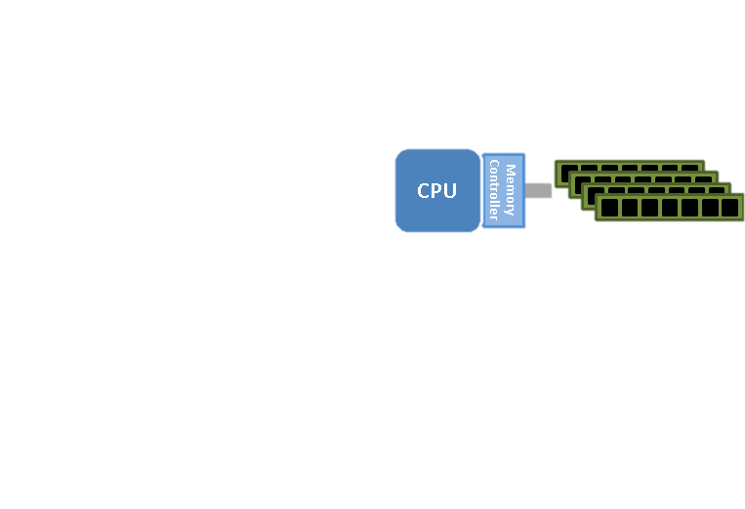
Today
Single Machine, Multi-core

Slide 4

Today
(Maximally) Asynchronous
Processor 1
Processor 2
Processor P

Slide 5
Today
Serial Equialence
For all Data sets S
For all data order π (data points can be arbitrarily repeated)
Main advantage:
- we only need to “prove” speedups
- Convergence proofs inherited directly from serial
Main Issue:
- Serial equivalence too strict
- Cannot guarantee any speedups in the general case

Slide 6
The Stochastic Updates
Meta-algorithm

Slide 7
Stochastic Updates
What does this solve?

Slide 8
Stochastic Updates: A family of ML Algorithms
Many algorithms with
sparse access patterns:
SGD
SVRG / SAGA
Matrix Factorization
word2vec
K-means
Stochastic PCA
Graph Clustering
…
Data points
Variables
1
2
n
Can we parallelize under Serial Equivalence?

Slide 9
A graph view of Conflicts
in Parallel Updates

Slide 10
The Update Conflict Graph
An edge between 2 updates if they overlap

Slide 11
The Theorem
[Krivelevich’14]
sample
Lemma:
Sample less than vertices (with/without replacement)

Slide 12
The Theorem
[Krivelevich’14]
sample
Lemma:
Sample less than vertices (with/without replacement)
Then, the induced sub-graph shatters

Slide 13
The Theorem
[Krivelevich’14]
sample
C.C.
Lemma:
Sample less than vertices (with/without replacement)
Then, the induced sub-graph shatters,
The largest connected component has size
Even if the Graph was a Single Huge Conflict Component!

Slide 14
Building a Parallelization Framework out of a Single Theorem

Slide 15
Sample Batch + Connected Components
Phase 1
sample
Sample vertices

Slide 16
Sample Batch + Connected Components
Phase 1
sample
C.C.
Sample vertices

Slide 17
Sample Batch + Connected Components
Phase 1
sample
C.C.
Sample vertices
Compute Conn. Components
NOTE: No conflicts across groups!
Max Conn. Comp = logn => n/(Δlogn) tiny components
Yay! Good for parallelization
No conflicts across groups = we can run Stochastic Updates on each of them in parallel!

Slide 18
Sample Batch + Connected Components
Phase 1
sample
C.C.
Allocation
Phase 1I
Core1
Core 2
Core p
Cores < Batch size / logn = n/(Δlogn)

Slide 19
Sample Batch + Connected Components
Phase 1
sample
C.C.
Allocation
Phase 1I
Core1
Core 2
Core p
Cores < Batch size / logn = n/(Δlogn)
A Single Rule: Run the updates serially inside each connected component
Automatically Satisfied since we give each conflict group to a single core.

Slide 20
Sample Batch + Connected Components
Phase 1
sample
C.C.
Allocation
Phase 1I
Core1
Core 2
Core p
Policy 1: Random allocation, good when cores << Batch size
Policy II: Greedy min-weight allocation
(80% as good as optimal (which is NP-hard))
A Single Rule: Run the updates serially inside each connected component
Automatically Satisfied since we give each conflict group to a single core.

Slide 21
Sample Batch + Connected Components
Phase 1
sample
C.C.
Allocation
Phase 1I
Core1
Core 2
Core p
Asynchronous and Lock-free Stochastic Updates
Phase III
SU
SU
SU
Core1
Core 2
Core p

Slide 22
Sample Batch + Connected Components
Phase 1
sample
C.C.
Allocation
Phase 1I
Core1
Core 2
Core p
Asynchronous and Lock-free Stochastic Updates
Phase III
SU
SU
SU
Core1
Core 2
Core p
Each core runs Asynchronously and Lock-free! (No communication!)

Slide 23
Sample Batch + Connected Components
Phase 1
sample
C.C.
Allocation
Phase 1I
Core1
Core 2
Core p
Asynchronous and Lock-free Stochastic Updates
Phase III
SU
SU
SU
Core1
Core 2
Core p
No memory Contention!
Not during Reads, neither during Writes!

Slide 24
Sample Batch + Connected Components
Phase 1
sample
C.C.
Allocation
Phase 1I
Core1
Core 2
Core p
Asynchronous and Lock-free Stochastic Updates
Phase III
SU
SU
SU
Core1
Core 2
Core p
Wait for Everyone to Finish

Slide 25
Sample Batch + Connected Components
Phase 1
sample
C.C.
Allocation
Phase 1I
Core1
Core 2
Core p
Asynchronous and Lock-free Stochastic Updates
Phase III
SU
SU
SU
Core1
Core 2
Core p
Wait for Everyone to Finish

Slide 27
Cyclades guarantees Serially Equivalence
But does it guarantee speedups?

Slide 28
Sample Batch + Connected Components
Phase 1
sample
C.C.
Allocation
Phase 1I
Core1
Core 2
Core p
Asynchronous and Lock-free Stochastic Updates
This is as fast as it gets
Phase III
SU
SU
SU
Core1
Core 2
Core p
Wait for Everyone to Finish

Slide 29
Sample Batch + Connected Components
If Phase I and II are fast
We are good.
Phase 1
Serial Cost:
sample
C.C.
Allocation
Phase 1I
Serial Cost:
Core1
Core 2
Core p
Asynchronous and Lock-free Stochastic Updates
This is as fast as it gets
Phase III
Serial Cost:
SU
SU
SU
Core1
Core 2
Core p
Wait for Everyone to Finish

Slide 30
Main Theorem
Note:
Serial Cost =
κ = cost / coordinate update
Speedup =
Assumptions:
Not too large max degree (approximate “regularity”)
Not too many cores
Sampling according to the “Graph Theorem”

Slide 31
Identical performance as serial for
SGD (convex/nonconvex)
SVRG / SAGA (convex/ nonconvex)
Weight decay
Matrix Factorization
Word2Vec
Matrix Completion
Dropout + Random coord.
- Greedy Clustering
Sample Batch + Connected Components
Phase 1
sample
C.C.
Allocation
Phase 1I
Core1
Core 2
Core p
Asynchronous and Lock-free Stochastic Updates
Phase III
SU
SU
SU
Core1
Core 2
Core p
Wait for Everyone to Finish

Slide 32
Fast Connected Components

Slide 33
Fast Connected Components
sample
C.C.
If you have the conflict graph CC is easy… O(Sampled Edges)
Building the conflict graph requires n^2 time…
No, thanks.

Slide 34
Fast Connected Components
Sample n/Δ left vertices
Sample on the Bipartite, not on the Conflict Graphs

Slide 35
Fast Connected Components
Simple Message passing Idea
-Gradients send their IDs
-Coordinates Compute Min and Send Back
-Gradients Compute Min and Send Back
Iterate till you’re done

Slide 36
Fast Connected Components
1
1
2
2
2
3
3
3
Simple Message passing Idea
-Gradients send their IDs
-Coordinates Compute Min and Send Back
-Gradients Compute Min and Send Back
Iterate till you’re done

Slide 37
Fast Connected Components
1
1
1
2
2
3
3
3
Simple Message passing Idea
-Gradients send their IDs
-Coordinates Compute Min and Send Back
-Gradients Compute Min and Send Back
Iterate till you’re done

Slide 38
Fast Connected Components
1
1
1
1
1
1
2
2
2
3
3
3
3
3
Simple Message passing Idea
-Gradients send their IDs
-Coordinates Compute Min and Send Back
-Gradients Compute Min and Send Back
Iterate till you’re done

Slide 39
Fast Connected Components
1
1
1
2
1
3
3
3
Simple Message passing Idea
-Gradients send their IDs
-Coordinates Compute Min and Send Back
-Gradients Compute Min and Send Back
Iterate till you’re done

Slide 40
Fast Connected Components
1
1
1
1
1
1
1
2
1
3
3
3
3
3
Simple Message passing Idea
-Gradients send their IDs
-Coordinates Compute Min and Send Back
-Gradients Compute Min and Send Back
Iterate till you’re done

Slide 41
Fast Connected Components
1
1
1
1
1
3
3
3
Simple Message passing Idea
-Gradients send their IDs
-Coordinates Compute Min and Send Back
-Gradients Compute Min and Send Back
Iterate till you’re done

Slide 42
Fast Connected Components
1
1
1
1
1
3
3
3
Simple Message passing Idea
-Gradients send their IDs
-Coordinates Compute Min and Send Back
-Gradients Compute Min and Send Back
Iterate till you’re done

Slide 43
Fast Connected Components
1
1
1
1
1
3
3
3
Cost =
Same assumptions as main theorem

Slide 44
Proof of “The Theorem”

Slide 45
The Theorem
sample
Lemma:
Activate each vertex with probability
p = (1-ε) /Δ
Then, the induced subgraph shatters,
and the largest connected component has size

Slide 46
DFS 101

Slide 47
DFS

Slide 48
DFS

Slide 49
DFS

Slide 50
DFS

Slide 51
DFS

Slide 52
DFS

Slide 53
DFS

Slide 54
DFS

Slide 55
Probabilistic DFS

Slide 56
DFS with random coins
Algorithm:
- Flip a coin for each vertex DFS wants to visit
- If 1 visit, if 0 don’t visit and delete with its edges

Slide 57
DFS with random coins
Algorithm:
- Flip a coin for each vertex DFS wants to visit
- If 1 visit, if 0 don’t visit and delete with its edges

Slide 58
DFS with random coins
Algorithm:
- Flip a coin for each vertex DFS wants to visit
- If 1 visit, if 0 don’t visit and delete with its edges

Slide 59
DFS with random coins
Algorithm:
- Flip a coin for each vertex DFS wants to visit
- If 1 visit, if 0 don’t visit and delete with its edges

Slide 60
DFS with random coins
Algorithm:
- Flip a coin for each vertex DFS wants to visit
- If 1 visit, if 0 don’t visit and delete with its edges

Slide 61
DFS with random coins
Algorithm:
- Flip a coin for each vertex DFS wants to visit
- If 1 visit, if 0 don’t visit and delete with its edges

Slide 62
DFS with random coins
Algorithm:
- Flip a coin for each vertex DFS wants to visit
- If 1 visit, if 0 don’t visit and delete with its edges

Slide 63
DFS with random coins
Algorithm:
- Flip a coin for each vertex DFS wants to visit
- If 1 visit, if 0 don’t visit and delete with its edges

Slide 64
DFS with random coins
Algorithm:
- Flip a coin for each vertex DFS wants to visit
- If 1 visit, if 0 don’t visit and delete with its edges

Slide 65
DFS with random coins
Algorithm:
- Flip a coin for each vertex DFS wants to visit
- If 1 visit, if 0 don’t visit and delete with its edges

Slide 66
DFS with random coins
Algorithm:
- Flip a coin for each vertex DFS wants to visit
- If 1 visit, if 0 don’t visit and delete with its edges

Slide 67
DFS with random coins
A Little extra trickery to turn this statement to a with or without replacement Theorem.
- Say I have a connected component of size k
- #random coins flipped “associated” to that component <= k *Δ
- Since I have a size k component it means that I had the event
“at least k coins are “ON” in a set of k * Δ coins”

Slide 68
Is Max.Degree really an issue?

Slide 69
High Degree Vertices
(outliers)
Say we have a graph with a low-degree component
+ some high degree vertices

Slide 70
High Degree Vertices
(outliers)
sample
Lemma:
If you sample uniformly less than vertices
Then, the induced subgraph of the low-degree (!) part shatters, and the largest connected component has size (whp)
is the max degree is the low-degree subgraph

Slide 71
High Degree Vertices
(outliers)
sample

Slide 72
Experiments

Slide 73
Experiments
Implementation in C++
Experiments on Intel Xeon CPU E7-8870 v3
1TB RAM
SAGA
SVRG
L2-SGD
SGD
Full asynchronous (Hogwild!)
vs
CYCLADES

Slide 74
Speedups
SVRG/SAGA
~ 500% gain
SGD
~ 30% gain

Slide 75
Convergence
Least Squares SAGA
16 threads

Slide 76
Open Problems
Assumptions:
Sparsity is Key
O.P. :
Can Cyclades handle Dense Data?
maybe…
Run HW updates on Dense and CYCLADES on sparse?
O.P. :
Data sparsification
for f(<a,x>) problems?
What other algorithms
are in Stochastic Updates?

Slide 77
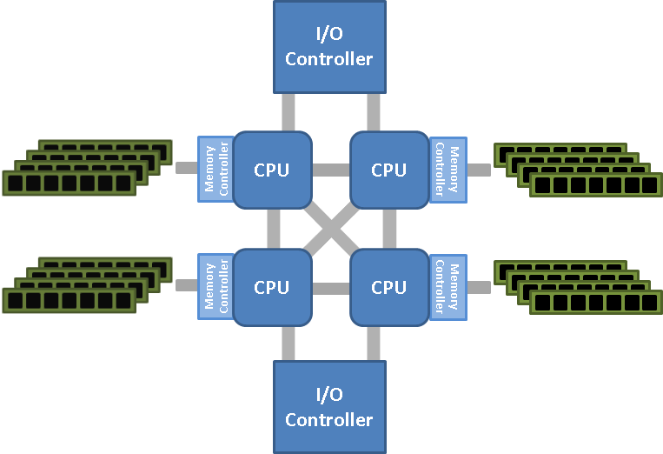
Open Problems
Asynchronous algorithms great for Shared Memory Systems
Issues when scaling across nodes
Similar Issues for Distributed:
speedup
#threads
O.P. :
How to provably scale on NUMA?
O.P. :
What is the right ML Paradigm
for Distributed?

Slide 78
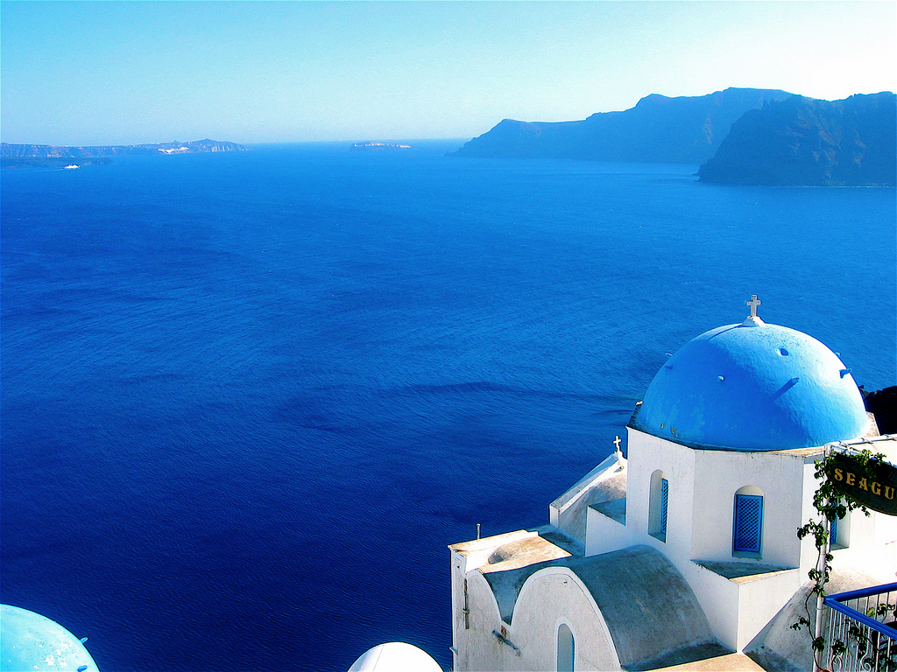
CYCLADES
a framework for Parallel Sparse ML algorithms
Lock-free + (maximally) Asynchronous
No Conflicts
Serializable
Black-box analysis

